Slide 1
Community Driven Accountability in Cambodia
An Oxfam-Monash Partnership Research Project

Slide 2
Central Goal
To investigate the factors enabling some communities to develop relatively stronger community-centred accountability processes than others, in relation to development projects that affect them

Slide 3
Key Investigation Areas
Understanding
of entitlement
to influence
Available forums for influence
Capacity to influence decision making
Role of NGOs and other external actors

Slide 4
Political Context in Cambodia
One party domination of political scene
Lack of downward accountability and respect for human rights
An aid dependent country but increasing investments from new donors such as China
Context of rapid economic development and investment

Slide 5
The Case Studies
Case studies of 3 development projects affecting communities
Rural/urban
At different stages of development and impact
Range of involved actors (government, companies, IFIs, NGOs)
Comparison of factors that strengthen or weaken
community-centred accountability processes

Slide 6
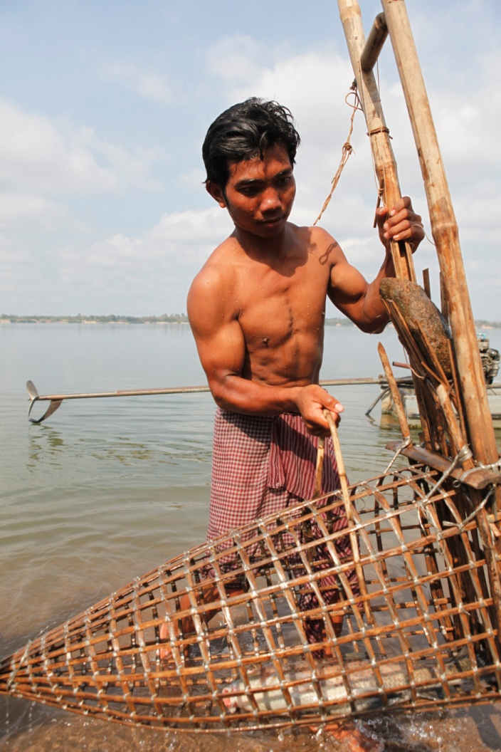
The Oxfam Australia Integrated Community Development Project

Slide 7
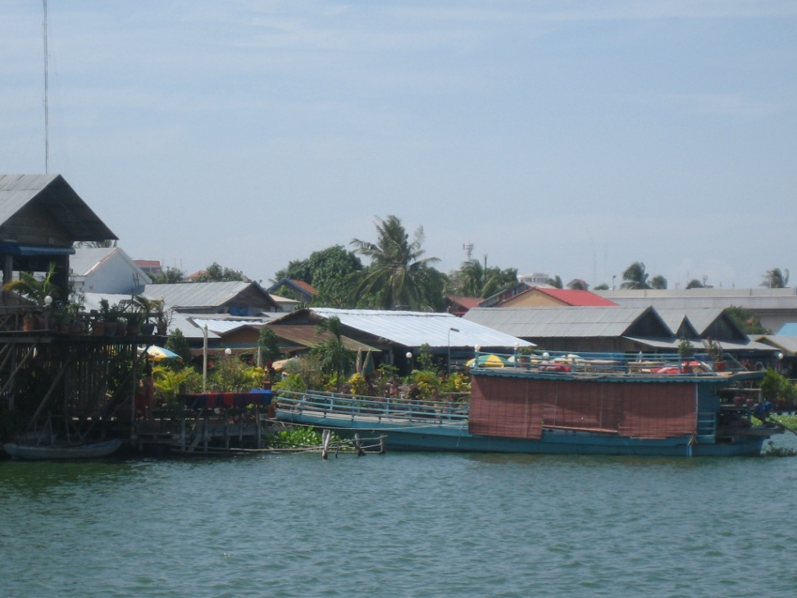
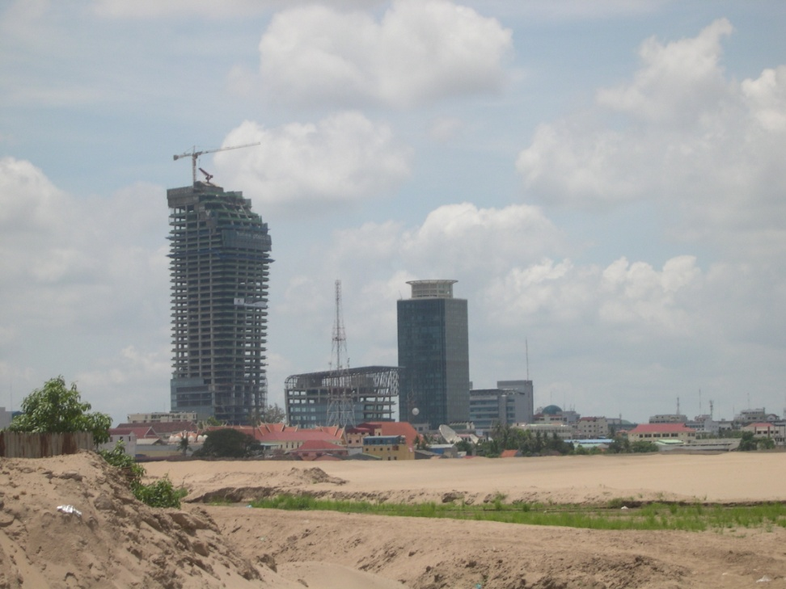
The Boeung Kak Lake Urban Development Project

Slide 8
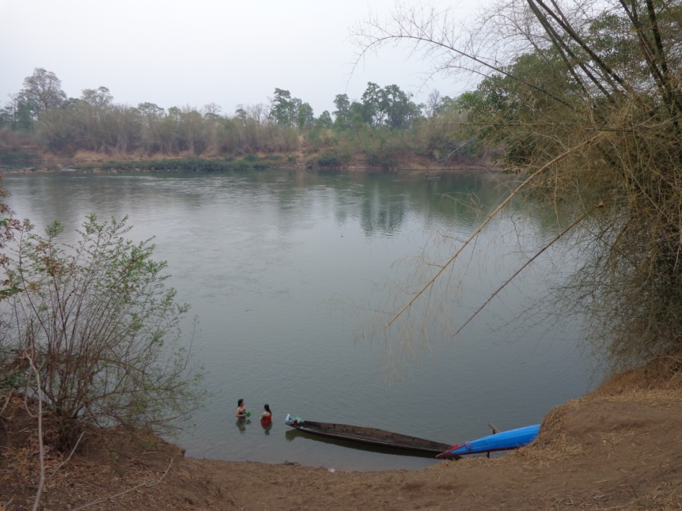
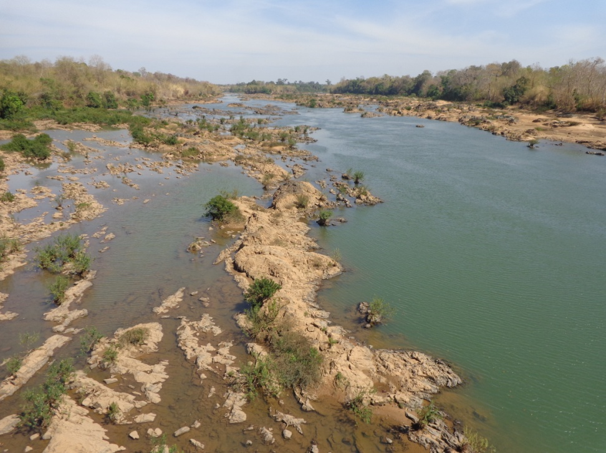
The Lower Sesan II Dam Project

Slide 9
Emerging Findings
The strength of accountability processes depends critically on a given community’s capacity and sense of entitlement to influence decisions about development projects that affect them
Community capacity and strength of entitlement to influence depend in turn on several factors, both internal and external to the community

Slide 10
Factors influencing capacity and entitlement
Quality of information, organization and resources at community level
Community norms and expectations, grounded in political culture
Roles, strategies and capacities of NGOs operating in the community
Relationships between communities, NGOs and government
Centralized versus decentralized structure of project decision-making

Slide 11
Towards Learning and Action
Disseminate findings to Oxfam and extended NGO community
Planning as to how the research can feed into OAU strategizing around the water governance work in Cambodia
Feeding in research to other Oxfam initiatives such as the Active Citizenship and Accountability hub

